Slide 1
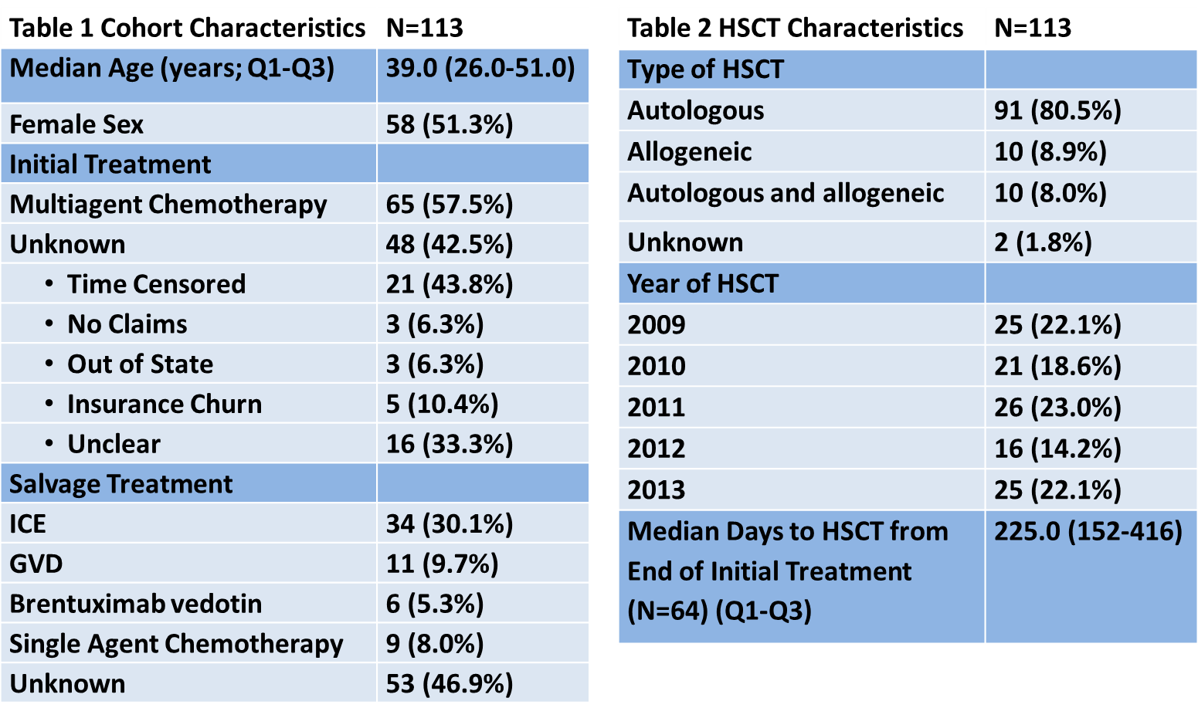
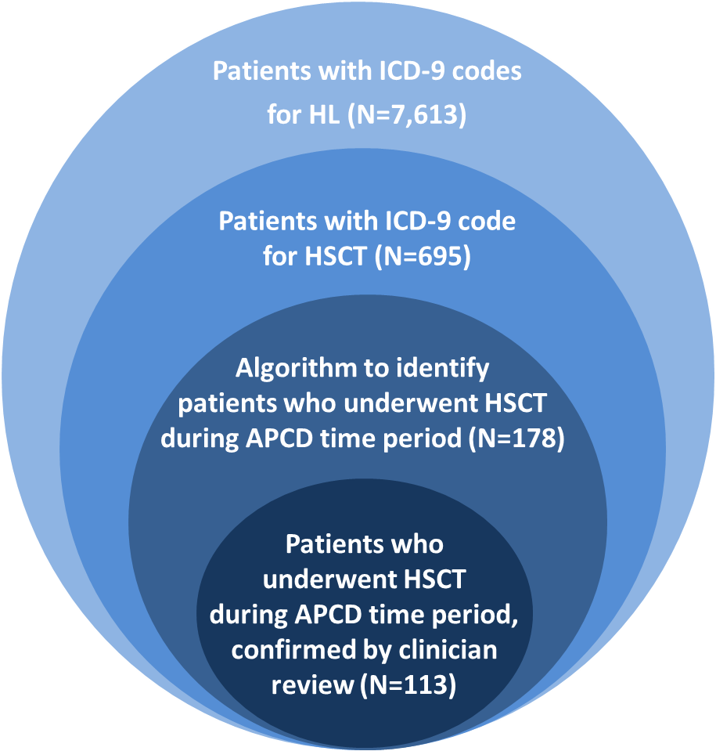
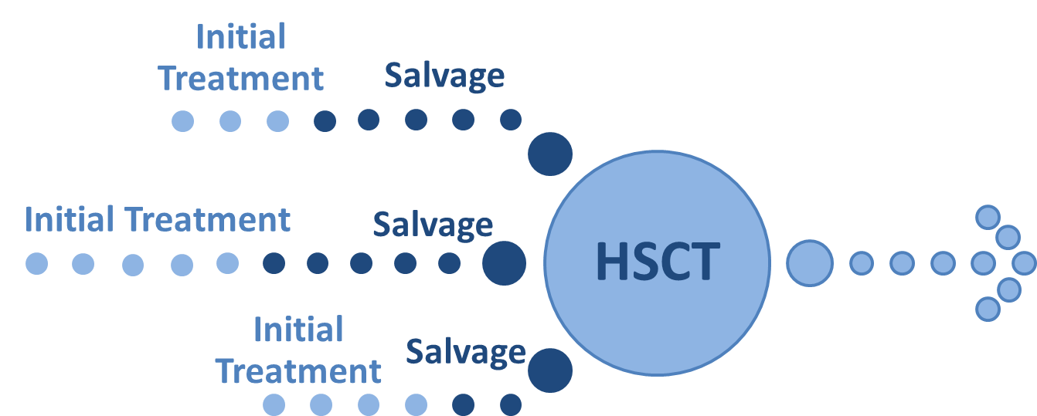
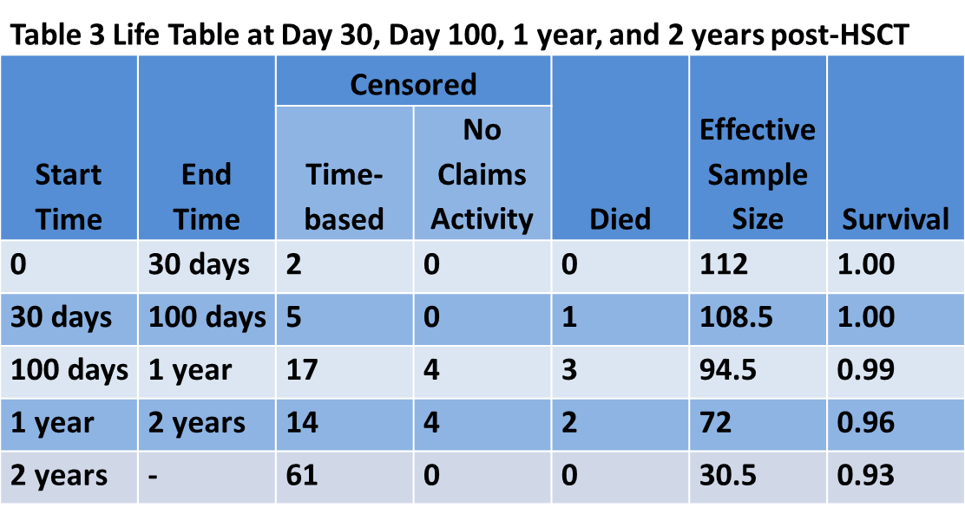
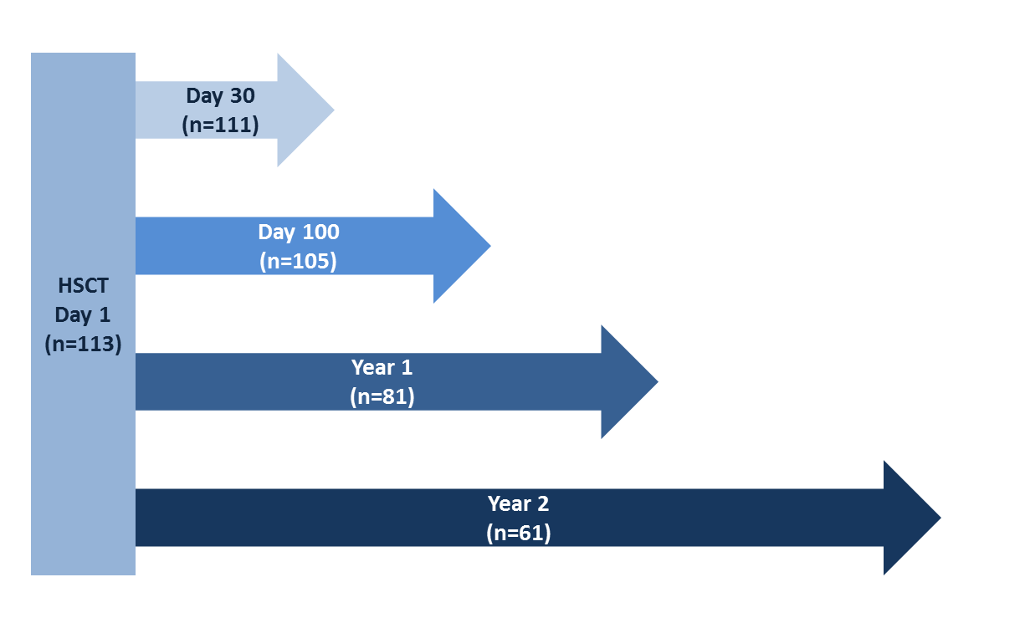
Hematopoietic Stem Cell Transplant Utilization in Relapsed/Refractory Hodgkin Lymphoma:
A Population Level Analysis of Statewide Claims Data
Anem Waheed, MD, MPH^{1,2}, Angie Mae Rodday, PhD, MS², Anita J. Kumar, MD, MS^{1,2}, Kenneth B. Miller, MD¹, Susan K. Parsons, MD, MRP^{1,2}
¹Division of Hematology/Oncology, ²Institute for Clinical Research & Health Policy Studies, Tufts Medical Center, Boston, MA
Background
Methods
Results
In the era of novel therapies, the first and subsequent lines of therapies are rapidly evolving in the treatment of patients with Hodgkin lymphoma (HL).
To optimize disease control and reduce long term health risks, further research about treatment failure and costs is necessary.
Hematopoietic stem cell transplant (HSCT) is often used following treatment failure.
While utilization of HSCT can be ascertained from transplant-specific registries, the treatment path for patients with relapsed/refractory HL leading up to HSCT is largely unknown.
We developed an algorithm to define a cohort of commercially insured patients with HL from 2009-2013 in the Massachusetts All Payer Claims Database (MA APCD) who received HSCT.
Figures 1 & 2. Establishing a Cohort of Patients
Methods
In the MA APCD each patient is assigned a unique identifier, which allows us to follow patients even if they change insurer.
We identified a cohort of 7,613 cases with ICD-9 diagnostic codes for HL. Among this cohort, 695 had ICD-9 codes for both HL and HSCT. (Figure 1)
To identify incident HSCT cases during our study period, we developed and iteratively refined an algorithm using ICD-9 diagnostic and procedure codes, dates of service, and length of stay which narrowed the cohort to 178 patients.
113 patients were identified as part of the final cohort who underwent autologous and/or allogeneic HSCT.
Reasons for exclusion include not HL (34), not HSCT (8), and prevalent (i.e. “history of”) HSCT only (23).
After identification of the cohort, we summarized initial treatment, salvage treatment, and HSCT. (Figures 2 & 3).
Figure 3 Number of Patients with Claims Available Post-HSCT
Conclusions
We successfully developed and refined an algorithm to help identify HSCT among patients with HL within a large statewide claims database.
We characterized a cohort of patients with relapsed/refractory HL, including patterns of initial and salvage treatments as well as post-HSCT survival time.
Future directions include determining utilization and cost of care during the different phases of treatment for HL. Additionally, analysis of different sites of care within community and academic practices and referral patterns for HSCT will be performed.
Funding
This project was funded in part by a research grant from Leukemia & Lymphoma Society and an institutional research grant from Seattle Genetics.

